Slide 1
Group 1
ANALYSIS OF AN ONLINE FOOD DELIVERY PLATFORM
Porter Food Delivery Service

Slide 2








Project Team
Ansh Gangdev
Farman Zaidi
Jeet Patel
Kivan
Ilangakoon
Palak Singla
Shyam Soni
Project Manager
Research Lead
Presentation Designer
Data Modeler
Visualization Specialist
Quality Assurance/Re
viewer

Slide 3

Content
01
02
03
04
05
06
07
08
Overview of Data
Problem Statement
Solution & Implementation
Data Preprocessing
Analysis & Model Development
Data Visualization
Benefits
Challenges

Slide 4
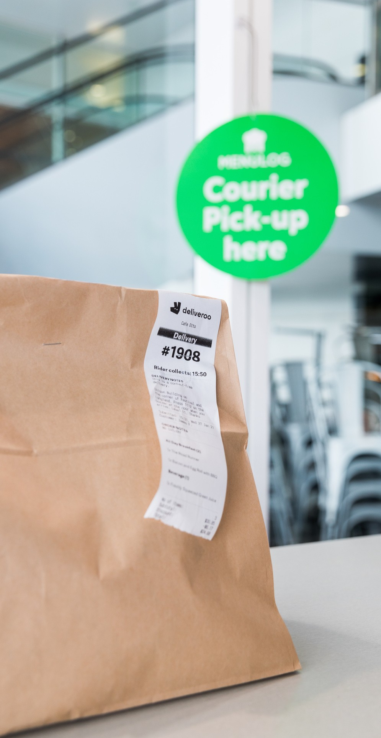


Overview
Dataset captures market dynamics of an online food delivery platform.
Provides insights into customer preferences, order traits, and market behavior.
Data covers food orders placed through the platform. Spans from early 2015.
Includes details like order creation and delivery timestamps.
Contains store information, food categories, and order metrics.

Slide 5



Market & Store Information
Food Delivery Ecosystem
Order Metrics
Data Insights
Order Timing and Protocol
Visualization and Analysis
Partner Information

Slide 6


Problem
Statement
Optimize partner resource allocation
Identify peak demand periods Enhance partner efficiency

Slide 7







Solution & Implementation
Data-Driven Visualization Strategy
Peak Period Identification
Market- Specific Insights
Comprehensive Methodology
Implementation Process

Slide 8


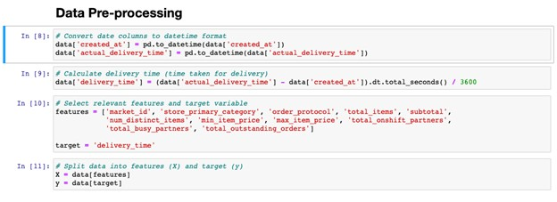
Convert Date Columns to Datetime Format
Calculate Delivery Time
Select Relevant Features and Target Variable
Split Data into Features and Target

Slide 9


5
Model
Performance Evaluation
4
Predicting
Delivery Time
Analysis
3
Training a Linear Regression
Model
2
Data Splitting for Training and
Testing
1
One- hot Encoding

Slide 10


5
Model
Performance Evaluation
4
Predicting
Delivery Time
Analysis
3
Training a Linear Regression
Model
2
Data Splitting for Training and
Testing
Evaluation Results
MAE ≈ 0.2
RMSE ≈ 0.29
1
One- hot Encoding

Slide 11
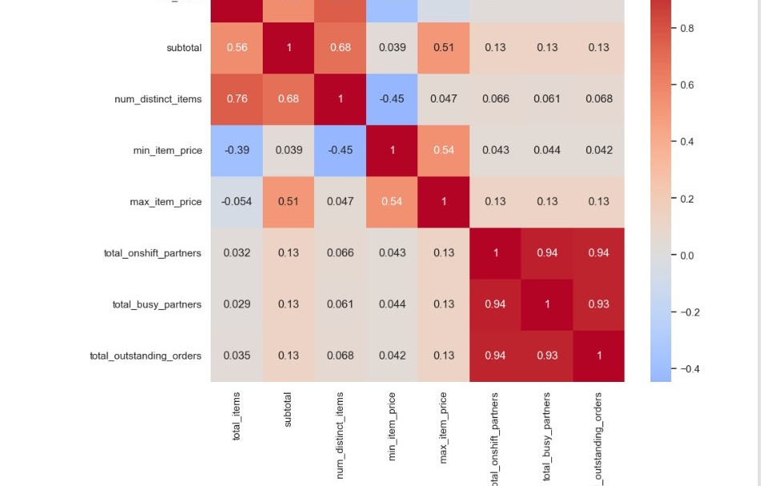
Data Visualizations
Correlation Matrix

Slide 12
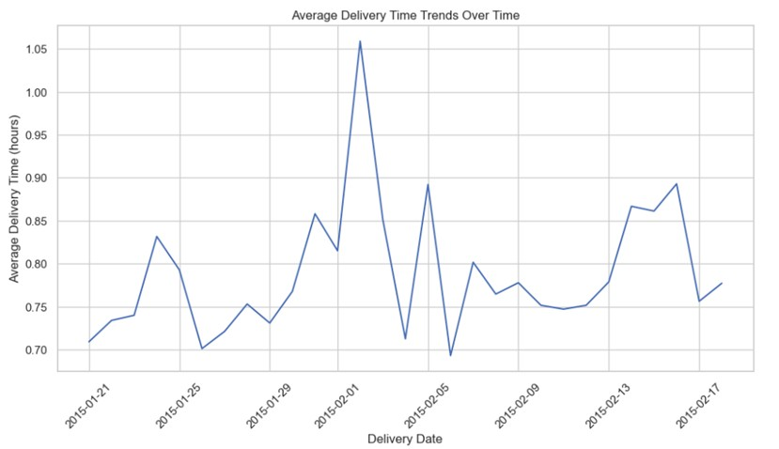
Data Visualizations
Delivery Time Vs Date

Slide 13

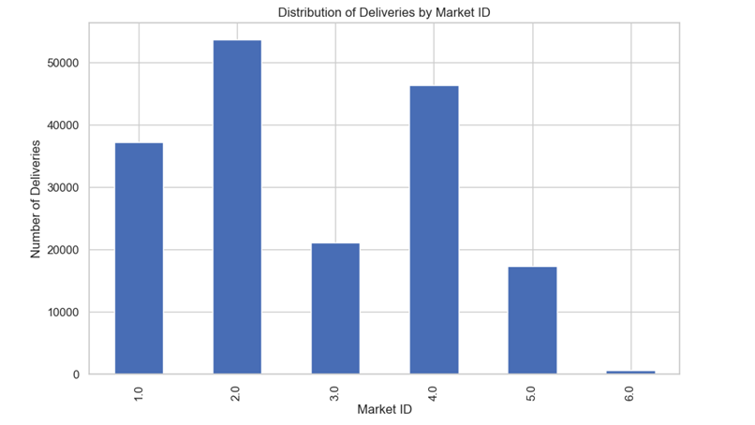
Data Visualizations
Distribution of Deliveries

Slide 14
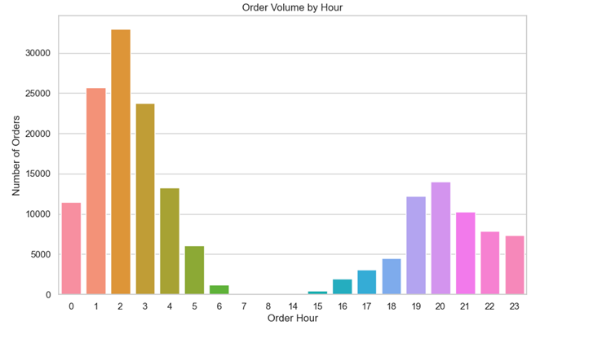
Data Visualizations
Order Volumes by hour

Slide 15
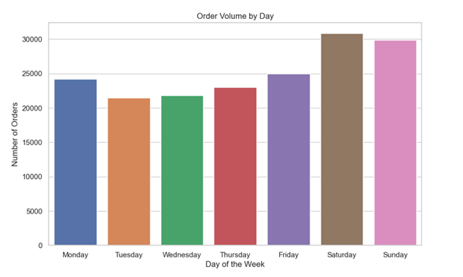
Data Visualizations
Order Volumes by day

Slide 16

Benefits
Enhanced Decision-Making
Efficiency Improvement
Resource Allocation Optimization Customer Satisfaction Operational Insights
Competitive Advantage

Slide 17

Challenges
Data Quality and Completeness
Feature Selection and Engineering Handling Categorical Data
Bias and Fairness Concerns Preventing Overfitting

Slide 18



THANK YOU

